Slide 1
8.2 Extended Facts: Multiplication and Division
Miss Hager

Slide 2
Record a related multiplication fact for each division fact and then use the multiplication fact to find the answer. 30 ÷ 6=?
Bell Ringer

Slide 3
Record a related multiplication fact for each division fact and then use the multiplication fact to find the answer. 40 ÷ 10=?
Bell Ringer

Slide 4
Record a related multiplication fact for each division fact and then use the multiplication fact to find the answer. 27 ÷ 9=?
Bell Ringer

Slide 5
Record a related multiplication fact for each division fact and then use the multiplication fact to find the answer. 49 ÷ 7=?
Bell Ringer

Slide 6
Record a related multiplication fact for each division fact and then use the multiplication fact to find the answer. 27 ÷ 9 =?
Bell Ringer

Slide 7
Record a related multiplication fact for each division fact and then use the multiplication fact to find the answer. 42 ÷ 6 =?
Bell Ringer

Slide 8
Record a related multiplication fact for each division fact and then use the multiplication fact to find the answer. 54 ÷ 9 =?
Bell Ringer

Slide 9
Record a related multiplication fact for each division fact and then use the multiplication fact to find the answer. 42 ÷ 6 =?
Bell Ringer

Slide 10
Math Message
The field day racetrack is 80 meters long. How many meters will the racers travel if they run the track 8 times?

Slide 11
Math Message
The field day racetrack is 80 meters long. How many meters will the racers travel if they run the track 8 times?
Answer:

Slide 12
Multiples of 10
10,20,30,40,50,60,70,80,etc.
Vocabulary
8.2

Slide 13
Extended Facts
Facts involving multiples of 10, 100, and so on, that have a basic fact in them.
Vocabulary
8.2

Slide 14
Math Message
2 x 30 = ?
What could this be referring to?
2 groups of 30

Slide 15
Math Message
2 x 30 = ?
What could this be referring to?
2 groups of 30
What do I mean when I say: “3 tens”

Slide 16
Problems like 2 x 30 are called extended facts because a related basic multiplication fact can help you find the number of tens (or hundreds or thousands) in the solution.
What basic fact can help you solve 2 x 30?

Slide 17
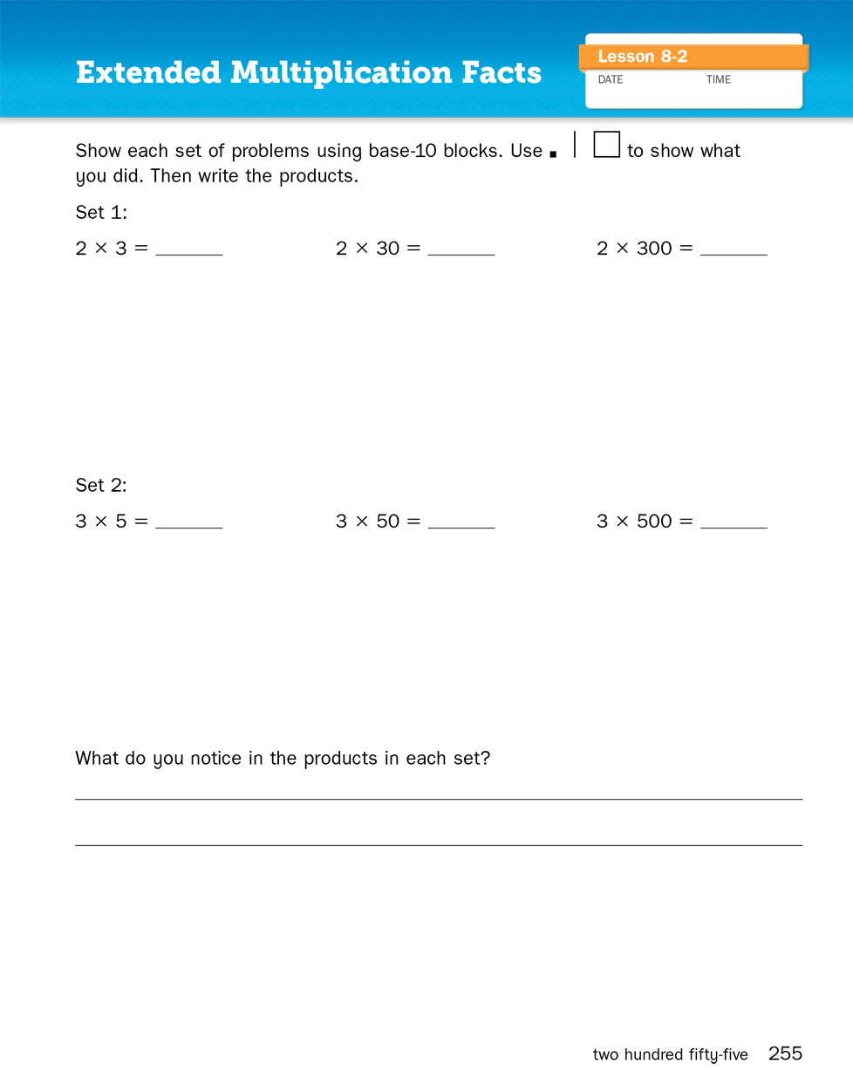
Journal Page 255

Slide 18
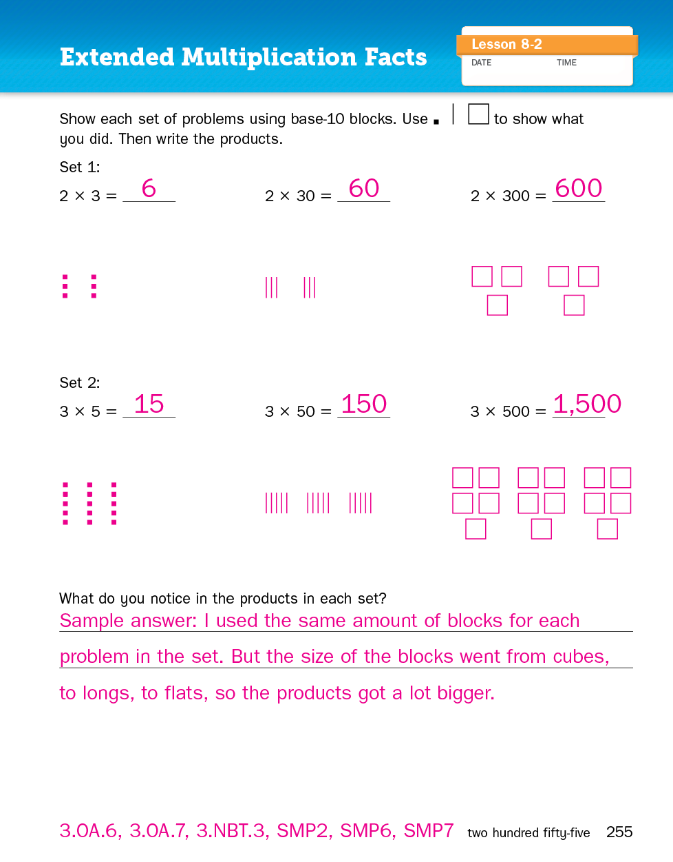
Journal Page 255

Slide 19
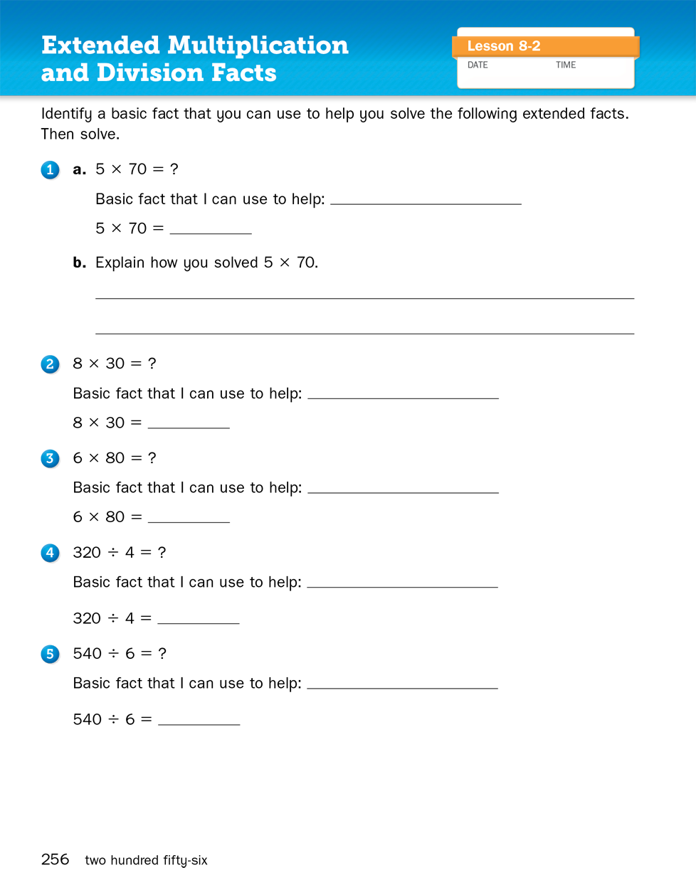
Journal Page 256

Slide 20
Extended Facts:
210 ÷ 3 = ?

Slide 21
Extended Facts:
630 ÷ 9 = ?

Slide 22
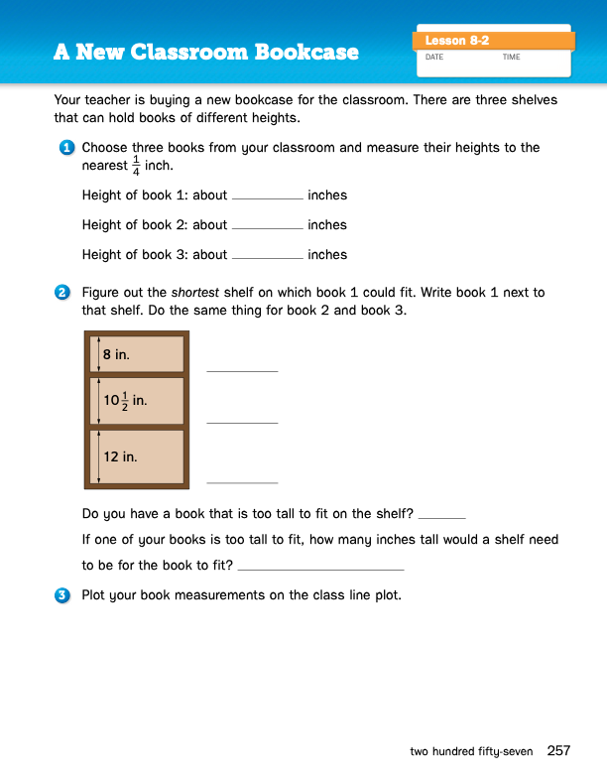
Journal Page 257

Slide 23
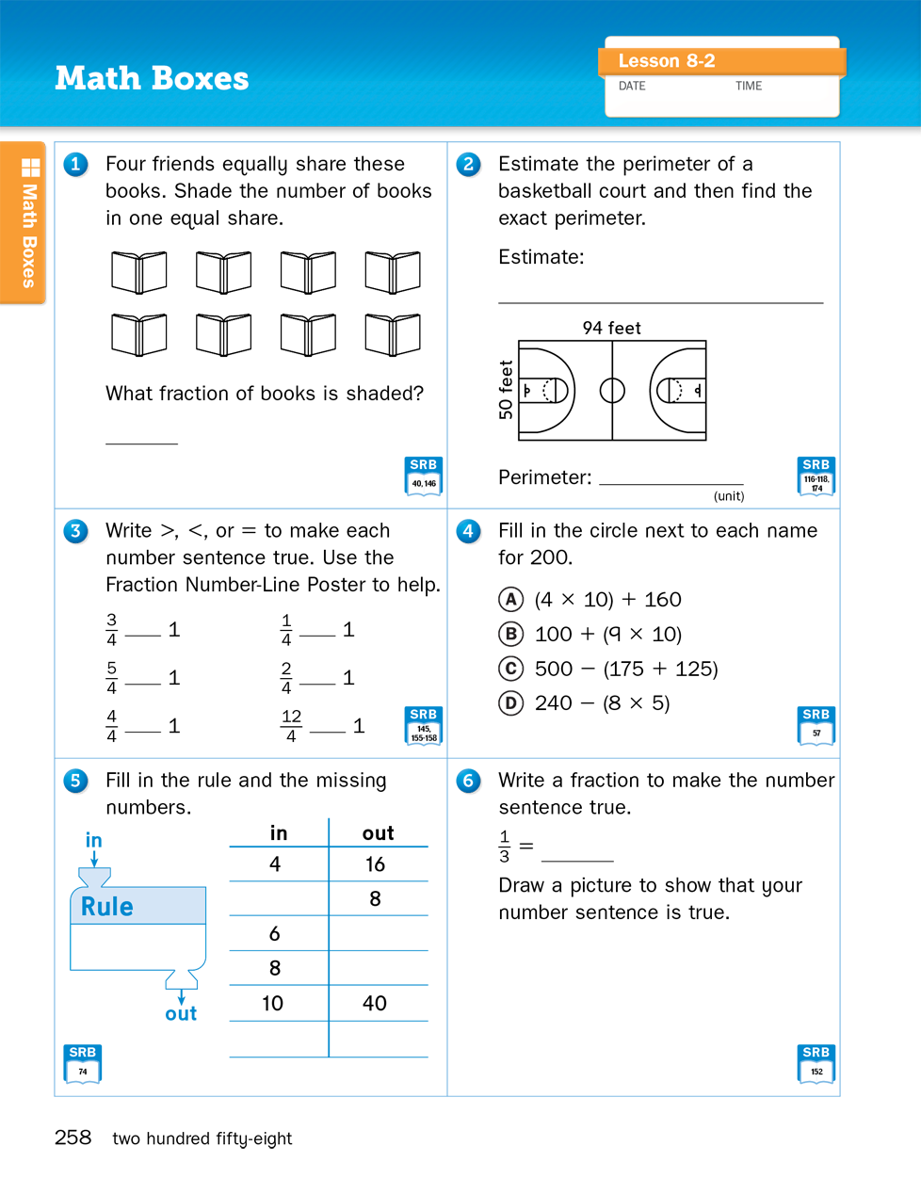
Math Boxes
Page 258

