Slide 1
Exploring Arrays, Volume, and Equal Shares
7.2 Miss Hager

Slide 2
Mental Math and Fluency
Bellringer: Subtract mentally and share your answer
1,000 – 500 = ?

Slide 3
Mental Math and Fluency
Bellringer: Subtract mentally and share your answer
1,000 – 300 = ?

Slide 4
Mental Math and Fluency
Bellringer: Subtract mentally and share your answer
1,000 – 800 = ?

Slide 5
Mental Math and Fluency
Bellringer: Subtract mentally and share your answer
1,000 – 250 = ?

Slide 6
Mental Math and Fluency
Bellringer: Subtract mentally and share your answer
1,000 – 950 = ?

Slide 7
Mental Math and Fluency
Bellringer: Subtract mentally and share your answer
1,000 – 750 = ?

Slide 8
Mental Math and Fluency
Bellringer: Subtract mentally and share your answer
1,000 – ? = 100

Slide 9
Mental Math and Fluency
Bellringer: Subtract mentally and share your answer
1,000 – ? = 600

Slide 10
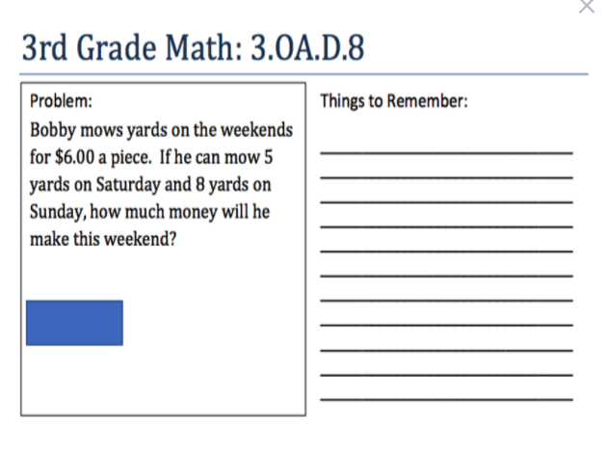

Slide 11
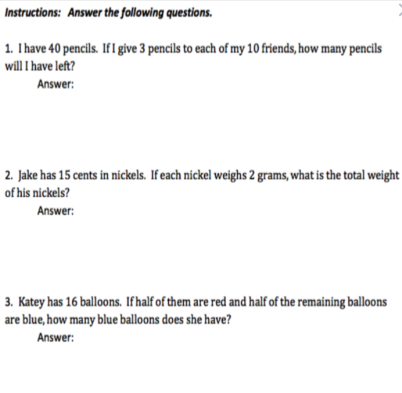

Slide 13
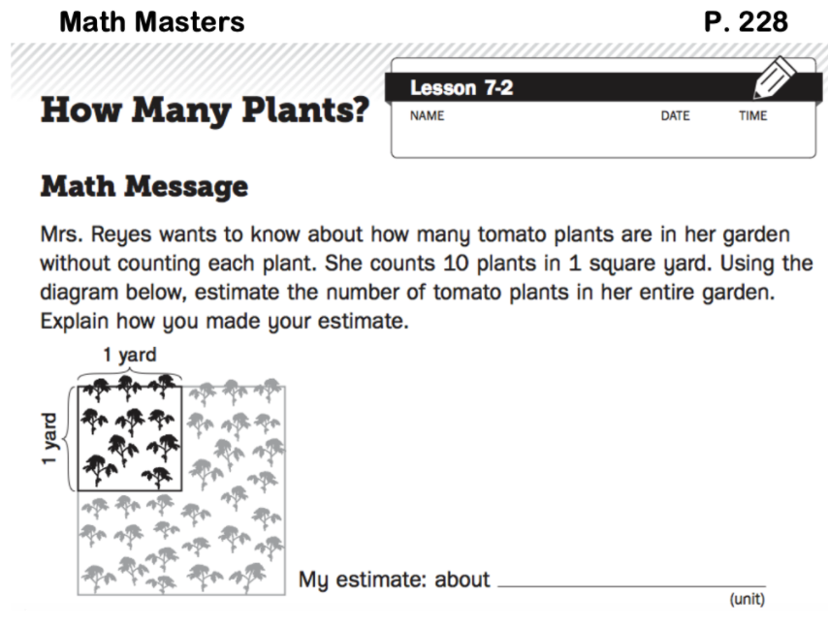

Slide 15
A
B
C
Exploration A:
Exploration B:
Exploration C:
How do you estimate the number of dots in an array?
How do you measure liquid volume?
How do you identify equal shares?
M
A
T
H

Slide 16
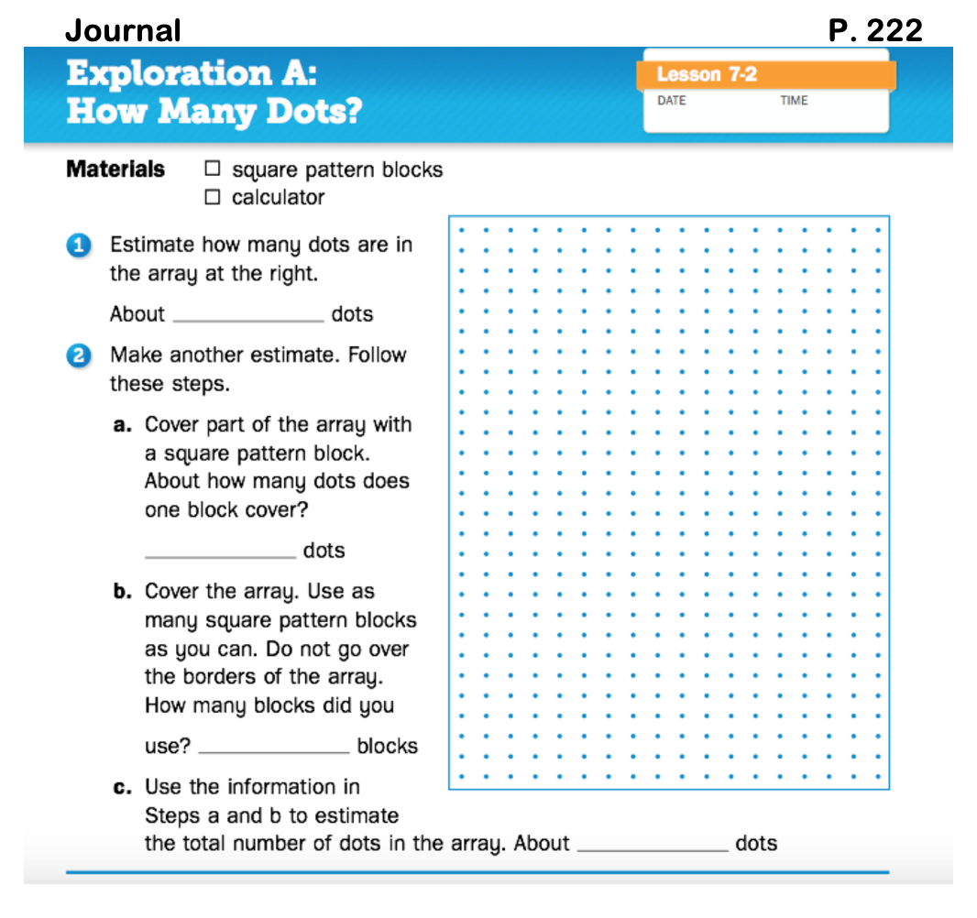

Slide 17
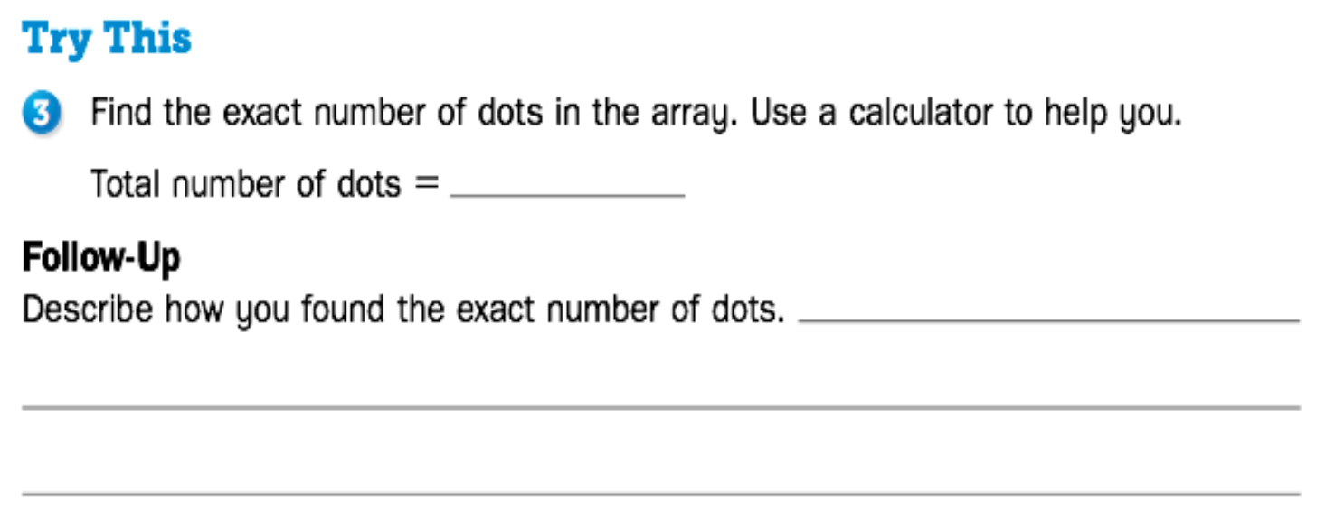

Slide 18
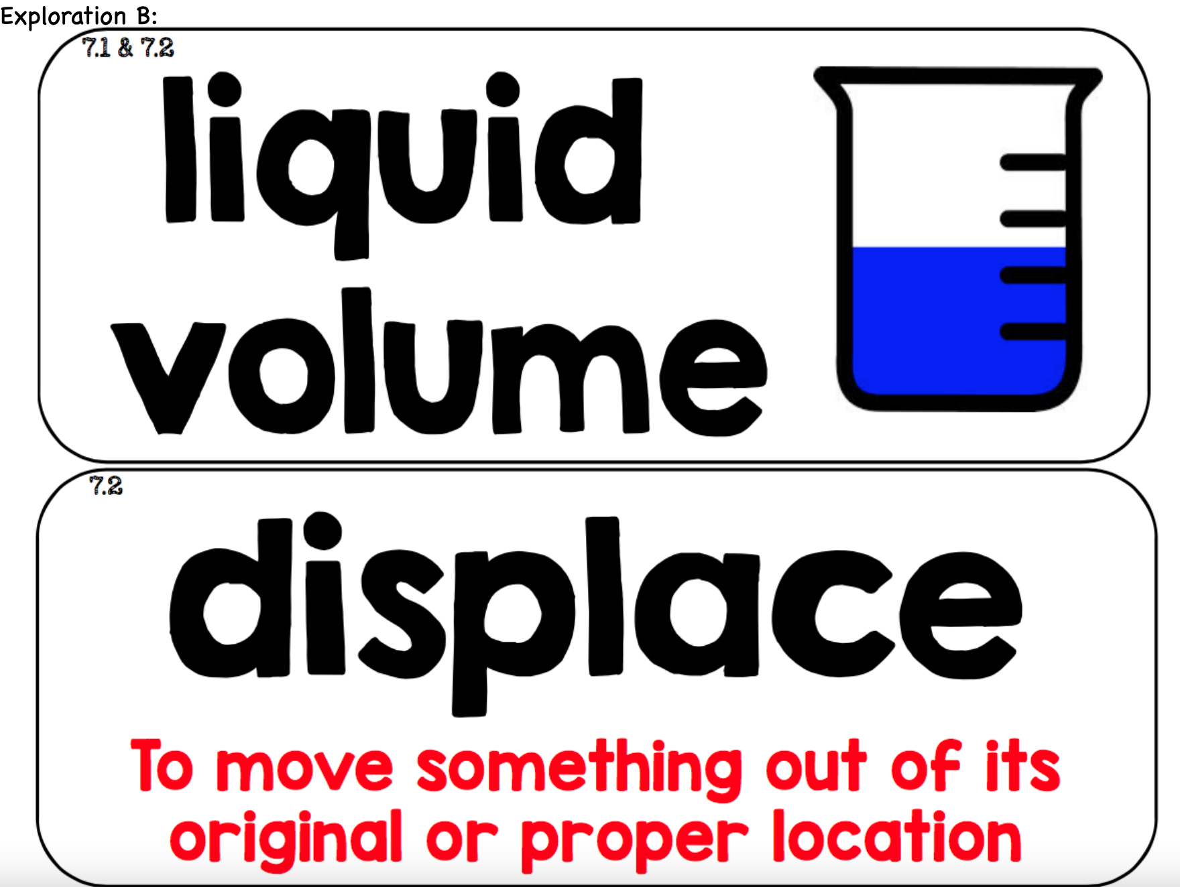

Slide 20
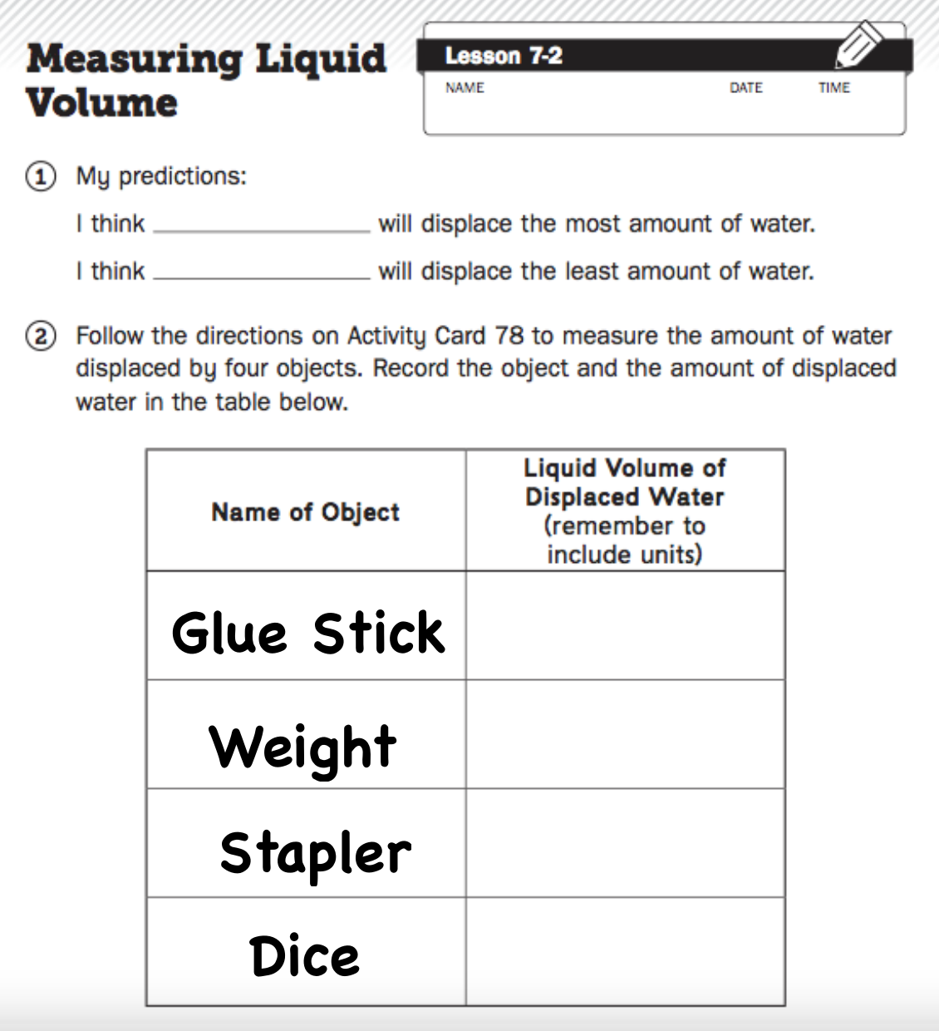

Slide 21
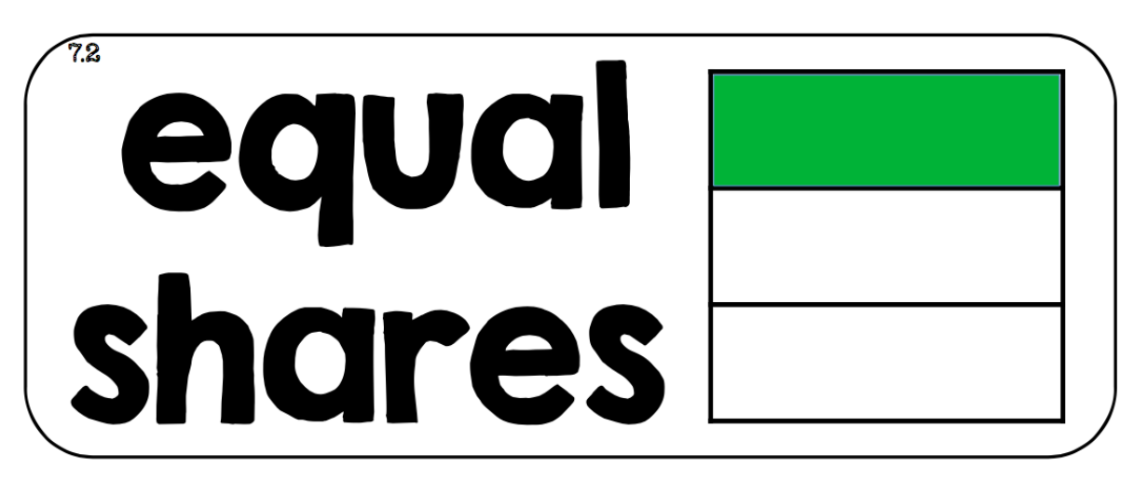

Slide 23
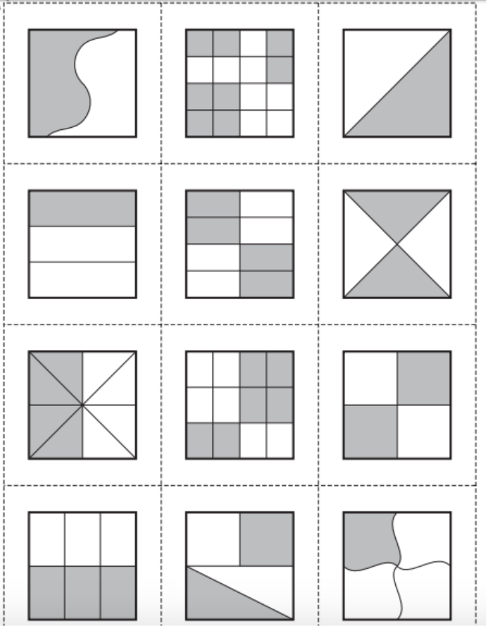

Slide 24
Summarize
How did you sort the Shares of Cornbread cards in Exploration C?

Slide 25
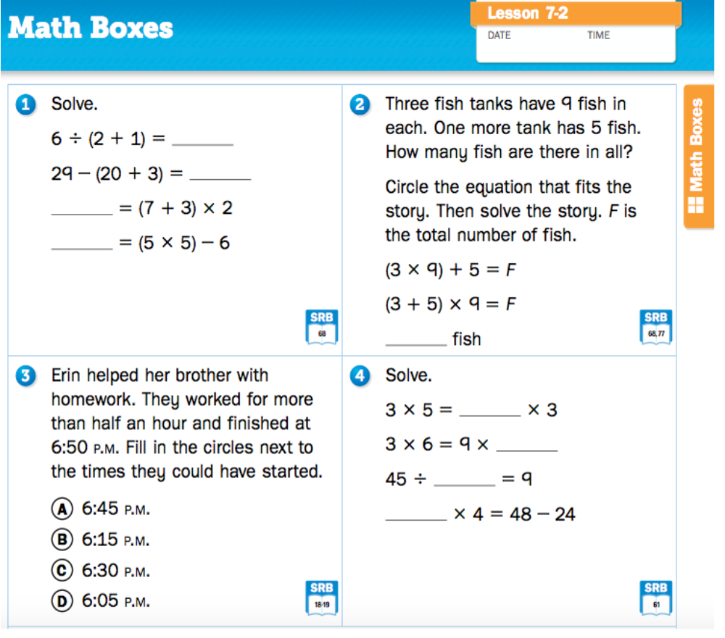

Slide 26
